Slide 1


PROPRIETARY AND CONFIDENTIAL
REIMBURSEMENT
MODELING & DECISION
SUPPORT
DATA DRIVEN; AI ENABLED CONTRACT ARBITRAGE

Slide 2

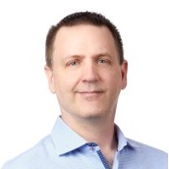
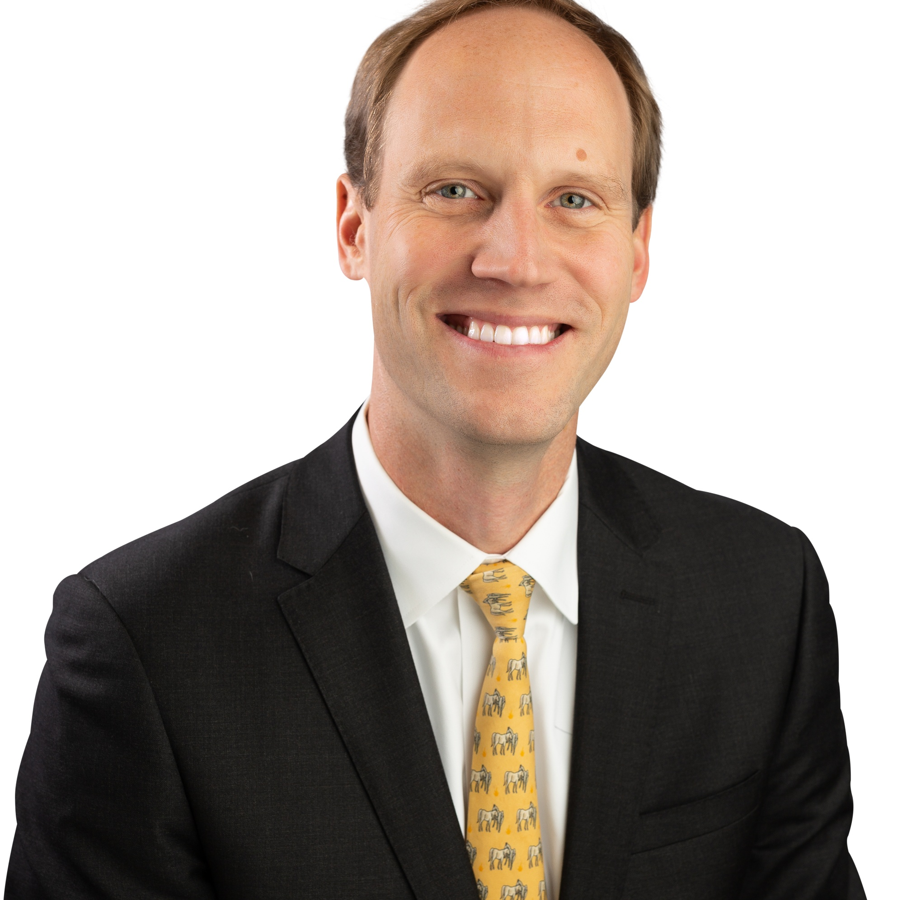
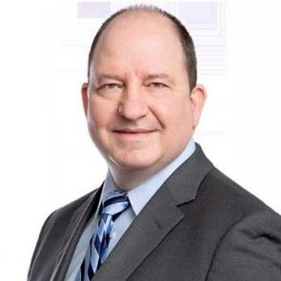
PROPRIETARY AND CONFIDENTIAL
MEET THE
Leadership Team
TIM MICHAELS
Chief Executive Officer
TOM SHERRARD
EVP, Sales & Market Development
JEFF SAGE
Chief Product Officer
(612) 747-5927
TIM@HEALTHRATE.IO
(612) 840-2908
Tom@HEALTHRATE.IO
(303) 877-9067
JEFF@HEALTHRATE.IO

Slide 3
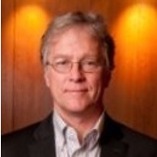
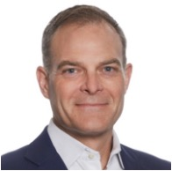
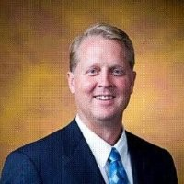



PROPRIETARY AND CONFIDENTIAL
MEET THE
Board of Advisors
BOB VAN WHY
Advisory Board
GEOFF BARTSH
Advisory Board
PAUL STORDAHL
Advisory Board
MARK NATHAN
Advisory Board
CONFIDENTIAL
Advisory Board

Slide 4


Thank you
FOR YOUR TIME
TIM MICHAELS
Chief Executive Officer
TIM@HEALTHRATE.IO
612-747-5927

